Slide 1
Chapter 2: Introduction to Relational Model
Notes:
1

Slide 2
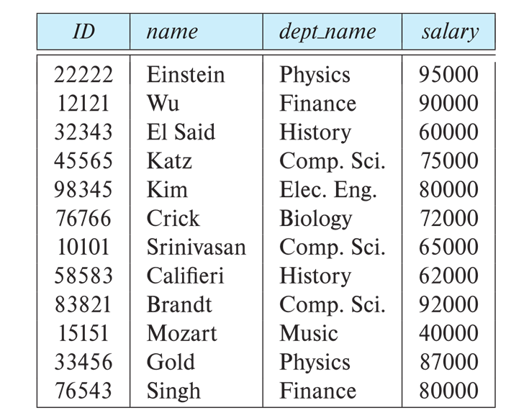
Database Schema
§Database schema -- is the logical structure of the database.
§Database instance -- is a snapshot of the data in the database at a given instant in time. Example:
•schema: instructor (ID, name, dept_name, salary)
•Instance:

Slide 3
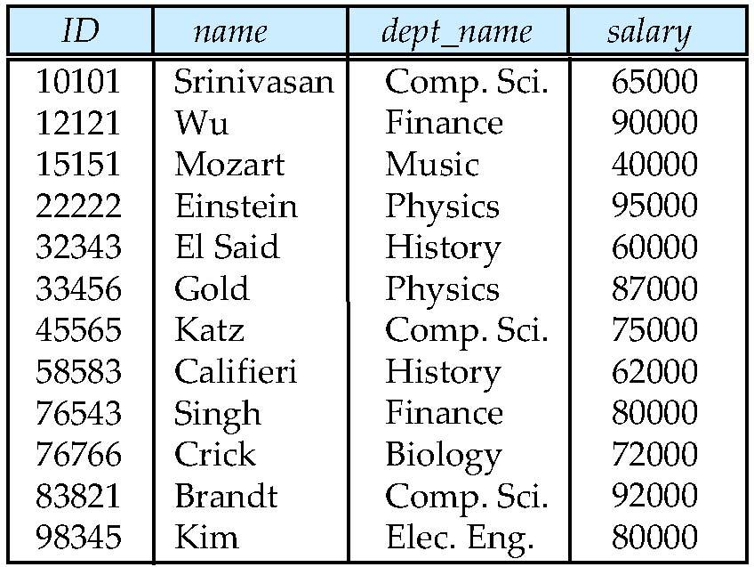
Example of a Relation
attributes
(or columns)
tuples
(or rows)
Notes:
3

Slide 4
Attribute Types
The set of allowed values for each attribute is called the domain of the attribute
Attribute values are (normally) required to be atomic; that is, indivisible
The special value null is a member of every domain. Indicated that the value is “unknown”
The null value causes complications in the definition of many operations
Notes:
4

Slide 5
Relation Schema and Instance
A₁, A₂, …, A_{n} are attributes
R = (A₁, A₂, …, A_{n} ) is a relation schema
Example:
instructor = (ID, name, dept_name, salary)
Formally, given sets D₁, D₂, …. D_{n} a relation r is a subset of D₁ x D₂ x … x D_{n} Thus, a relation is a set of n-tuples (a₁, a₂, …, a_{n}) where each a_{i} ∈ D_{i}
The current values (relation instance) of a relation are specified by a table
An element t of r is a tuple, represented by a row in a table
Notes:
5

Slide 6
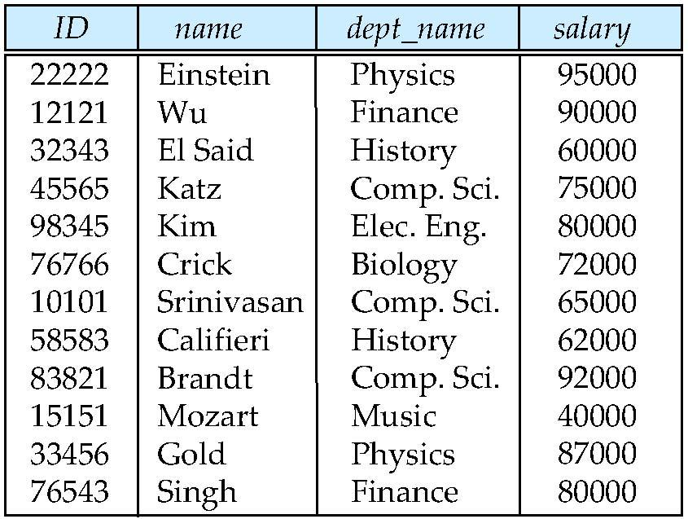
Relations are Unordered
Order of tuples is irrelevant (tuples may be stored in an arbitrary order)
Example: instructor relation with unordered tuples
Notes:
6

Slide 7
Keys
Let K ⊆ R
K is a superkey of R if values for K are sufficient to identify a unique tuple of each possible relation r(R)
Example: {ID} and {ID,name} are both superkeys of instructor.
Superkey K is a candidate key if K is minimal Example: {ID} is a candidate key for Instructor
One of the candidate keys is selected to be the primary key.
which one?
Notes:
7

Slide 8
Keys
A Foreign key constraint from attribute(s) A of relation r1 to the primary-key B of relation r2 states that on any database instance, the value of A for each tuple in r1 must also be the value of B for some tuple in r2.
Referencing relation – r1
Referenced relation – r2
Example – dept_name in instructor is a foreign key from instructor referencing department
A referential-integrity constraint, relaxes the requirement that the referenced attributes form the primary key of the referenced relation.
Foreign-key constraints are a special case of referential integrity constraints.
Notes:
8

Slide 9
Relational Constraints
Domain Constraints
• Every domain should be “Atomic”
Key Constraints Or Uniqueness Constraints
• No two tuples should be same
Entity Integrity Constraints
• No prime attribute value should be NULL
Referential Integrity Constraints
• Some attributes in a relation are referred from other relations

Slide 10
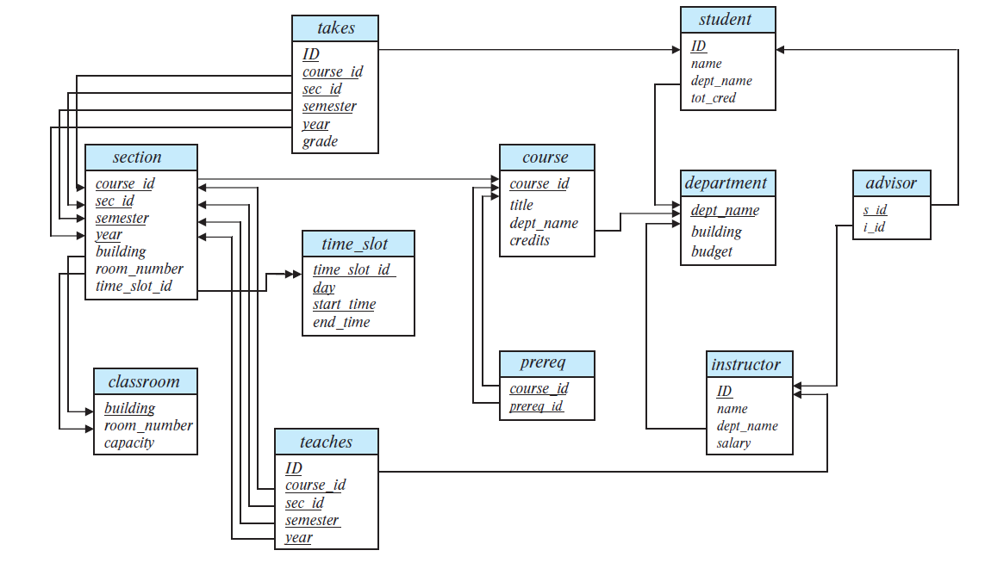
Schema Diagram for University Database

